Slide 1
Biodiversity for the National Parks

Slide 2
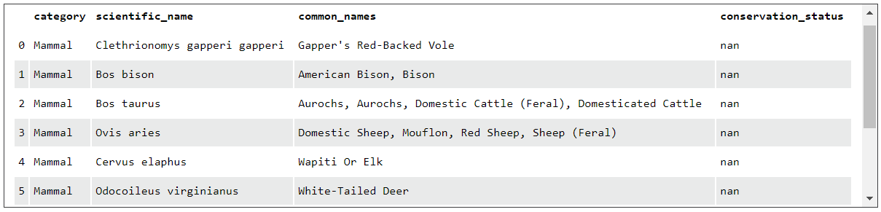
Describing the data in species_info.csv
The data file species_info.csv contains the following information under the headings seen below:
The data file contains 5541 records

Slide 3
Endangered Status between Different Species
The categories of species include: Mammal, Bird, Reptile, Amphibian, Fish, Vascular Plant and Non-vascular Pant
The number of species in each type of Conservation Status
Conservation Status | Number in Each Status
Endangered | 15
In Recovery | 4
No Intervention | 5363
Species of Concern | 151
Threatened | 10

Slide 4
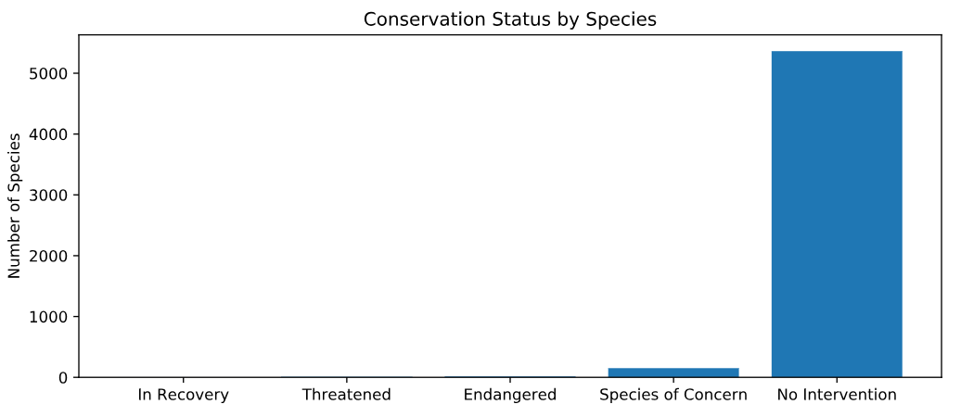

Slide 5
Are certain types of species more likely to be endangered?
Category | Not Protected | Protected | % Protected
Amphibian | 72 | 7 | 8.86
Bird | 413 | 75 | 15.37
Fish | 115 | 11 | 8.73
Mammal | 146 | 30 | 17.05
Non-vascular plant | 328 | 5 | 1.50
Reptile | 73 | 5 | 6.41
Vascular plant | 4216 | 46 | 1.08
It looks like Mammals are more likely to be endangered than Birds, but is it a significant difference? Our null hypothesis here is that this difference was a result of chance.
A Chi Squared Test for significance gave a significance value > 0.05 showing there is no significance, therefore the difference could be just chance.
We also looked at the difference between Mammals and Reptiles, this figure was < 0.05 showing that the difference was significant.
We can conclude that some species are more likely to be endangered.

Slide 6
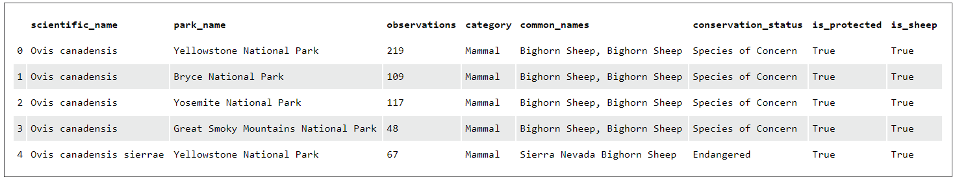
Foot and Mouth Disease Study Sample Size Determination
Data file: observations.csv

Slide 7
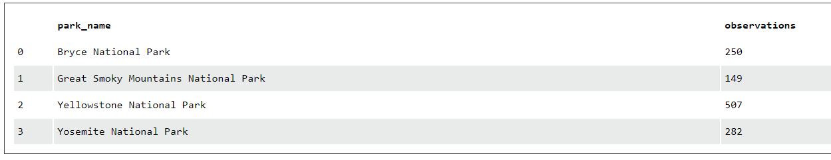
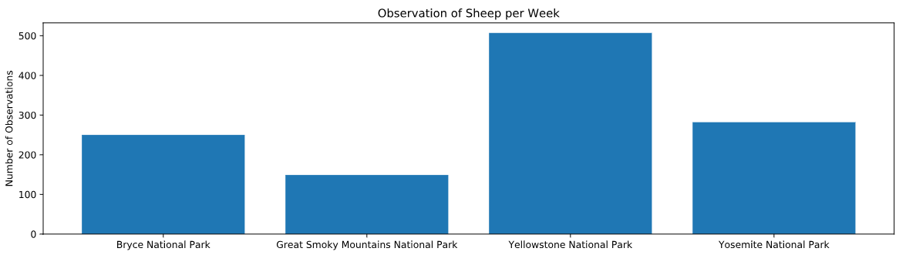
Observations of Sheep by National Park

Slide 8
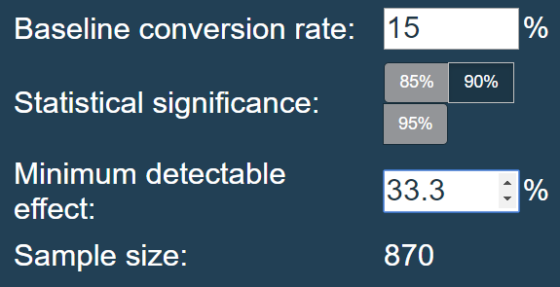
Foot and Mouth Reduction Effort
Park Rangers at Yellowstone National Park have been running a program to reduce the rate of foot and mouth disease at that park. The scientists want to test whether or not this program is working. They want to be able to detect reductions of at least 5 percentage points. For instance, if 10% of sheep in Yellowstone have foot and mouth disease, they'd like to be able to know this, with confidence.
The only information that the scientists currently have is that last year it was recorded that 15% of sheep at Bryce National Park have foot and mouth disease. Using this value and the sample size calculator in the browser window on the right, you will need to calculate the number of sheep that they would need to observe from each park to make sure their foot and mouth percentages are significant. Use the default level of significance (90%).
Using the Sample Size Calculator, we get a sample size of 870

Slide 9
Conclusion:
From this data we would need to observe Yellowstone NP for approximately 1.7 weeks and Bryce NP for approximately 3.5 weeks to see the required 870 sheep.

